Slide 1
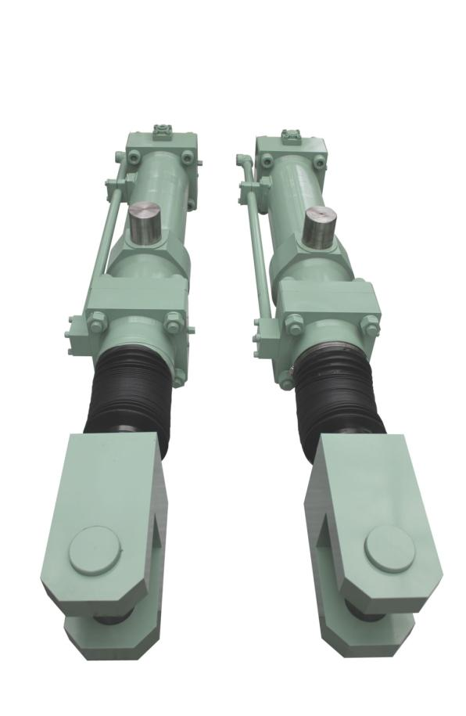


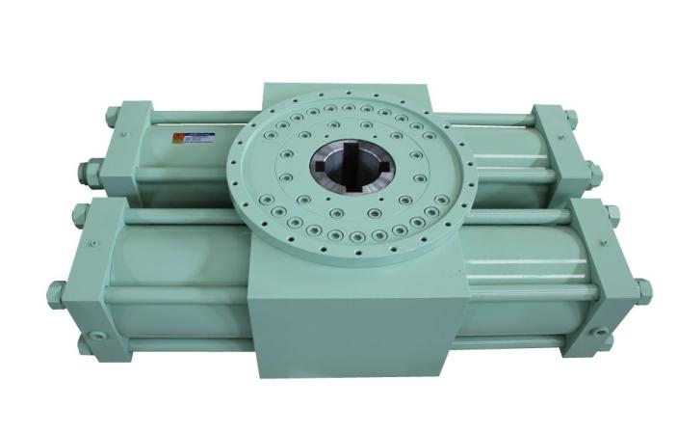
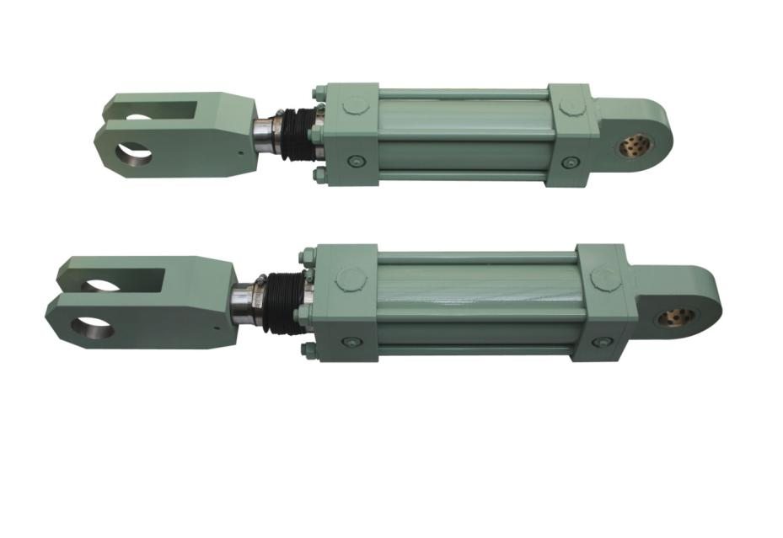

DAE WHA Hydraulics & Pneumatics
www.dhcyl.co.kr
Technology and quality as much as any third party may have a higher self-esteem.
But, not satisfied with the current for greater customer satisfaction Invitational will continue to
strive to develop new technologies promise.
The best quality, best service, new product development under a management philosophy that
is committed to innovation.
DAE WHA

Slide 2
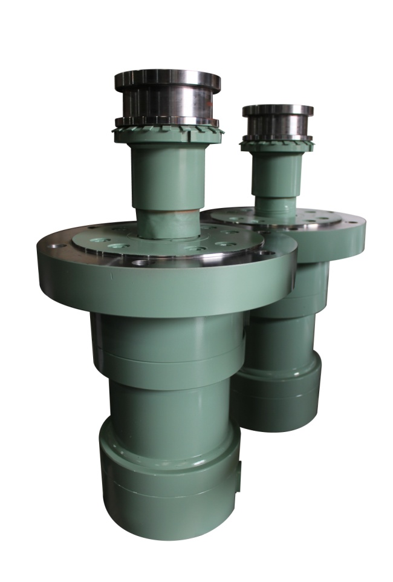
목차
01. 회사소개
02. 사 훈
03. 회사연혁
04. 사업 영역
05. 조직 및 인원현황
06. 공장 부지현황
07. 매출현황
08. 실적현황
09. 장비 보유현황
10. 검사 및 시험장비
11. 품질경영시스템 인증서
12. 주요 거래처
13. 오시는 길
www.dhcyl.co.kr
Technology and quality as much as any third party may have a higher self-esteem.
But, not satisfied with the current for greater customer satisfaction Invitational will continue to
strive to develop new technologies promise.
The best quality, best service, new product development under a management philosophy that
is committed to innovation.
DAE WHA

Slide 3
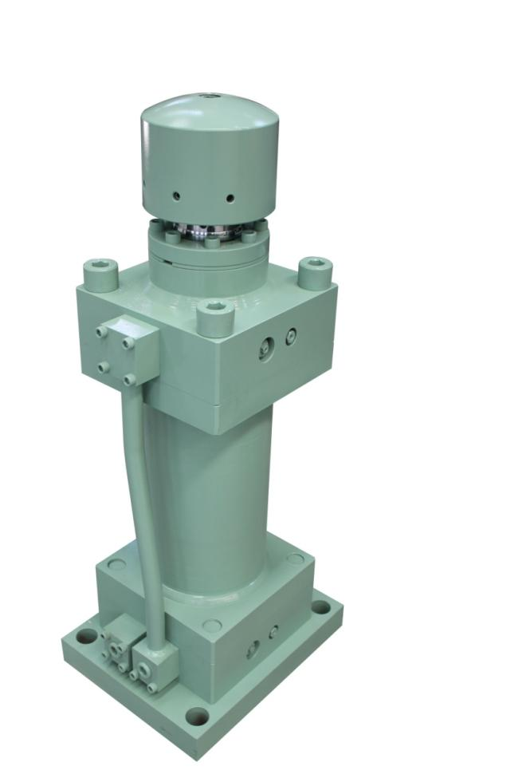

회사 소개
대화유공압은 1798년 창립 이후 풍부한 실무 경험을 통해 신기술, 신제품으로
실린더업계를 이끌어 오고 있습니다.
또한 혁신적인 기술로 제품의 대형화, 다양화, 고급화를 이루어 넓은 수요층을
확보하고 있으며 과감한 설비투자와 기술개발을 통한 다양한 첨단 제조설비를
구축하여 체계적인 생산시스템으로 산업 전반적인 수요에 부응하고 있습니다.
대화유공압은 국내 내수시장에서의 안정적인 유통망에 안주하지 않고
해외 수출시장으로의 도약을 위하여 끊임없이 노력하고 있습니다.
‘기술중심’, ‘고객만족’, ‘가치창조’ 의 경영으로 Cylinder업계에서 세계 최고의
경쟁력을 갖춘 글로벌 기업으로 거듭나겠습니다.
www.dhcyl.co.kr
Technology and quality as much as any third party may have a higher self-esteem.
But, not satisfied with the current for greater customer satisfaction Invitational will continue to
strive to develop new technologies promise.
The best quality, best service, new product development under a management philosophy that
is committed to innovation.
DAE WHA

Slide 4

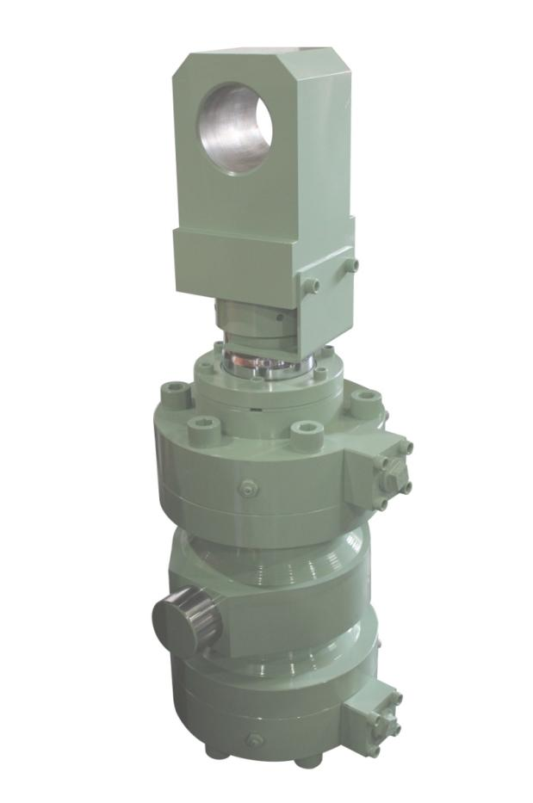


사훈
최고의 품질과 서비스,
끊임없는 신제품 개발로
고객만족 실현
고객만족
실린더 업계를 이끄는 ‘대화유공압’은
일류 기업으로 성장하기 위하여
최고의 품질과 서비스를 제공하고 있으며,
고객만족을 뒷받침 하기 위한 기술중심의 연구와 개발에
끊임없는 노력을 하고 있습니다.
또한 글로벌 기업의 가치를 창조하는
100년 기업이 될 수 있도록 하겠습니다.
기술중심
가치창조
www.dhcyl.co.kr
Technology and quality as much as any third party may have a higher self-esteem.
But, not satisfied with the current for greater customer satisfaction Invitational will continue to
strive to develop new technologies promise.
The best quality, best service, new product development under a management philosophy that
is committed to innovation.
DAE WHA

Slide 5
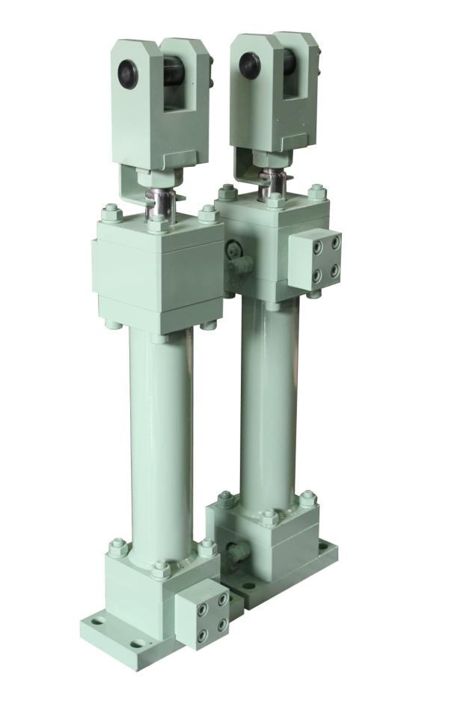
회사연혁
1978. 06 대화유공압 설립
1985. 07 서울영업소 설립
1986. 05 시흥 영업소 설립
2000. 07 현 소재지 자가공장 취득
2002. 08 ‘Q’마크인증(한국생활용품시험연구원)
2007. 08 ISO 9001 및 ISO 14001 (국제인증원 획득)
2008. 04 지식경제부 기술표준원장 부품소재 신뢰성 인증서 획득
2008. 12 현 소재지 자가공장 취득
2010. 03 기획재정부장관 모법납세자 표창장 수상
2011. 01 POSCO 제철소 납품업체 등록
2012. 06 POSCO 특수강 납품업체 등록
www.dhcyl.co.kr
Technology and quality as much as any third party may have a higher self-esteem.
But, not satisfied with the current for greater customer satisfaction Invitational will continue to
strive to develop new technologies promise.
The best quality, best service, new product development under a management philosophy that
is committed to innovation.
DAE WHA

Slide 6
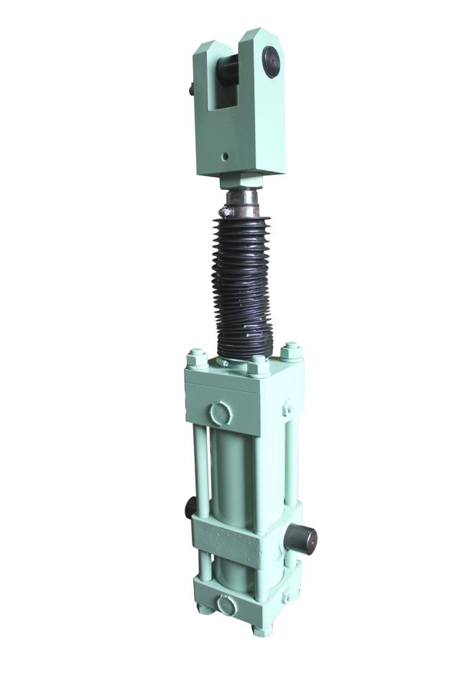
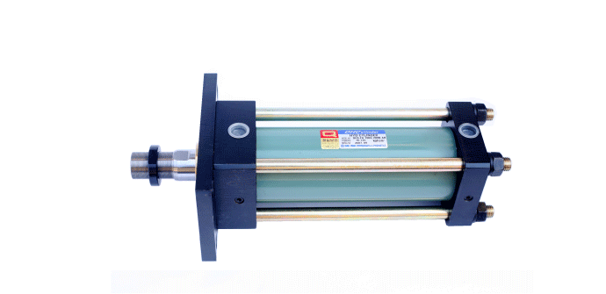
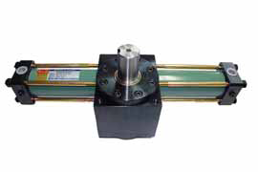
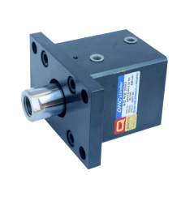
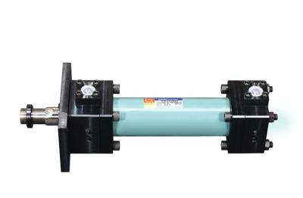
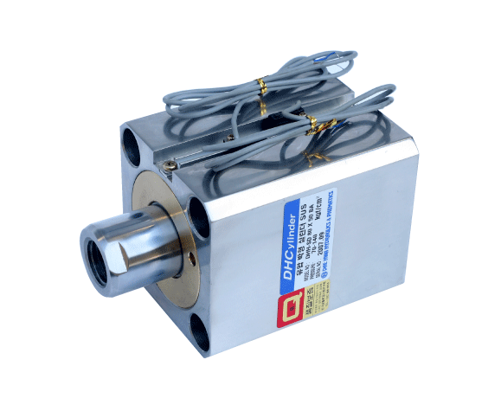
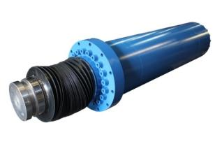
사업영역
유압사각실린더
회전실린더
박형실린더
SUS박형실린더
원형실린더
제철실린더
www.dhcyl.co.kr
Technology and quality as much as any third party may have a higher self-esteem.
But, not satisfied with the current for greater customer satisfaction Invitational will continue to
strive to develop new technologies promise.
The best quality, best service, new product development under a management philosophy that
is committed to innovation.
DAE WHA

Slide 7

조직 및 인원현황
대표
관리부
생산부
영업부
설계부
자재관리팀(2名)
재무관리팀(2名)
가공팀(27名)
조립팀(10名)
품질관리팀(2名)
용접팀(4名)
영업팀(3名)
설계 1팀(2名)
설계 2팀(3名)
www.dhcyl.co.kr
Technology and quality as much as any third party may have a higher self-esteem.
But, not satisfied with the current for greater customer satisfaction Invitational will continue to
strive to develop new technologies promise.
The best quality, best service, new product development under a management philosophy that
is committed to innovation.
DAE WHA

Slide 8
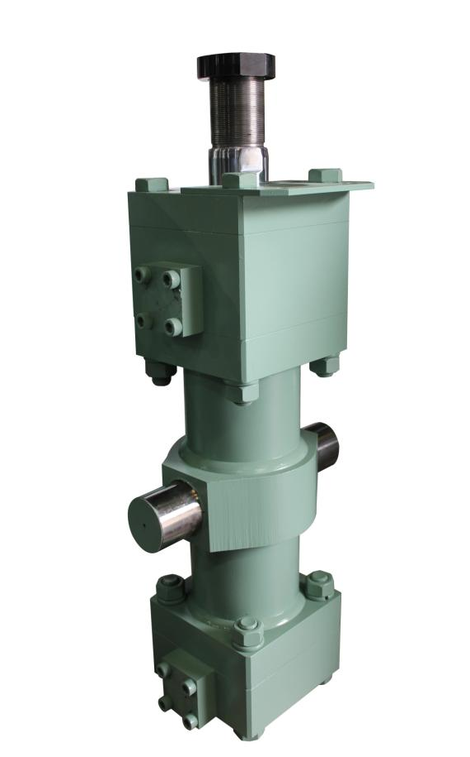
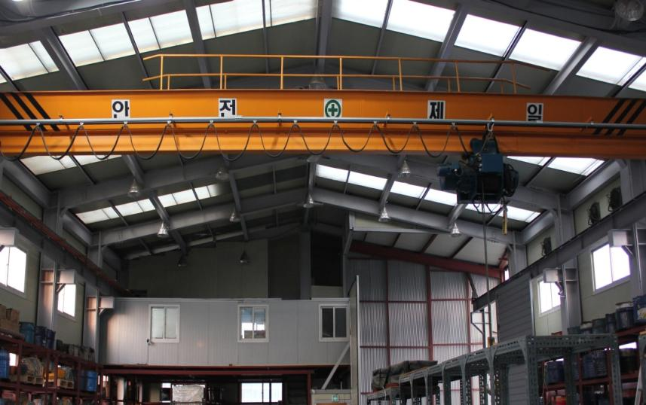
공장 부지 현황
◆ 공장 면적 : 제1공장 – 300평, 제2공장 – 500평
www.dhcyl.co.kr
Technology and quality as much as any third party may have a higher self-esteem.
But, not satisfied with the current for greater customer satisfaction Invitational will continue to
strive to develop new technologies promise.
The best quality, best service, new product development under a management philosophy that
is committed to innovation.
DAE WHA

Slide 9
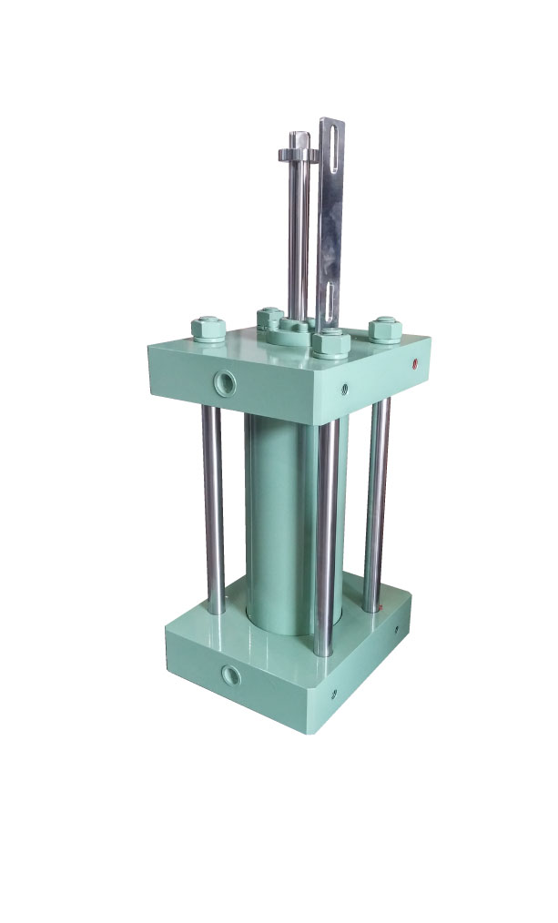
매출현황
(단위 : 억)
www.dhcyl.co.kr
Technology and quality as much as any third party may have a higher self-esteem.
But, not satisfied with the current for greater customer satisfaction Invitational will continue to
strive to develop new technologies promise.
The best quality, best service, new product development under a management philosophy that
is committed to innovation.
DAE WHA

Slide 10
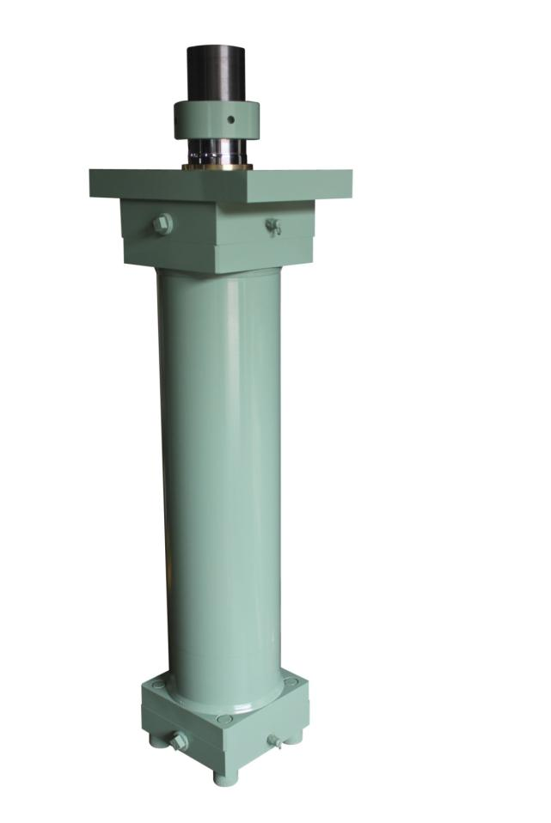
실적현황-1
계 약 명 | 계약금액 (단위:천원) | 제작 년도 | 규 격 | 최종 사용처
POSCO [BPA] | 300,000 | 11~14년 | Φ280 x 1190ST Φ280 x 5800ST | 냉연부-4냉연공장 등
부산거재터널공사 | 1,200,000 | 05~14년 | Φ350 x 4900ST | 현대중공업
소양강뎀터널공사 | 849,600 | 05~14년 | Φ350 x 4000ST | 삼성중공업
지게차워터치 | 13,800,000 | 07~14년 | Φ50 x 395ST Φ70 x 630ST Φ80 x 800ST | 두산중공업 현대중공업
PRESS LINE | 720,000 | 08~14년 | Φ285 x 400ST (300ton) Φ350 x 500ST (400ton) Φ370 x 800ST (500ton) Φ580 x 650ST (600ton) Φ650 x 800ST (800ton) Φ710 x 500ST (1000ton) | 삼성전자 등
www.dhcyl.co.kr
Technology and quality as much as any third party may have a higher self-esteem.
But, not satisfied with the current for greater customer satisfaction Invitational will continue to
strive to develop new technologies promise.
The best quality, best service, new product development under a management philosophy that
is committed to innovation.
DAE WHA

Slide 11
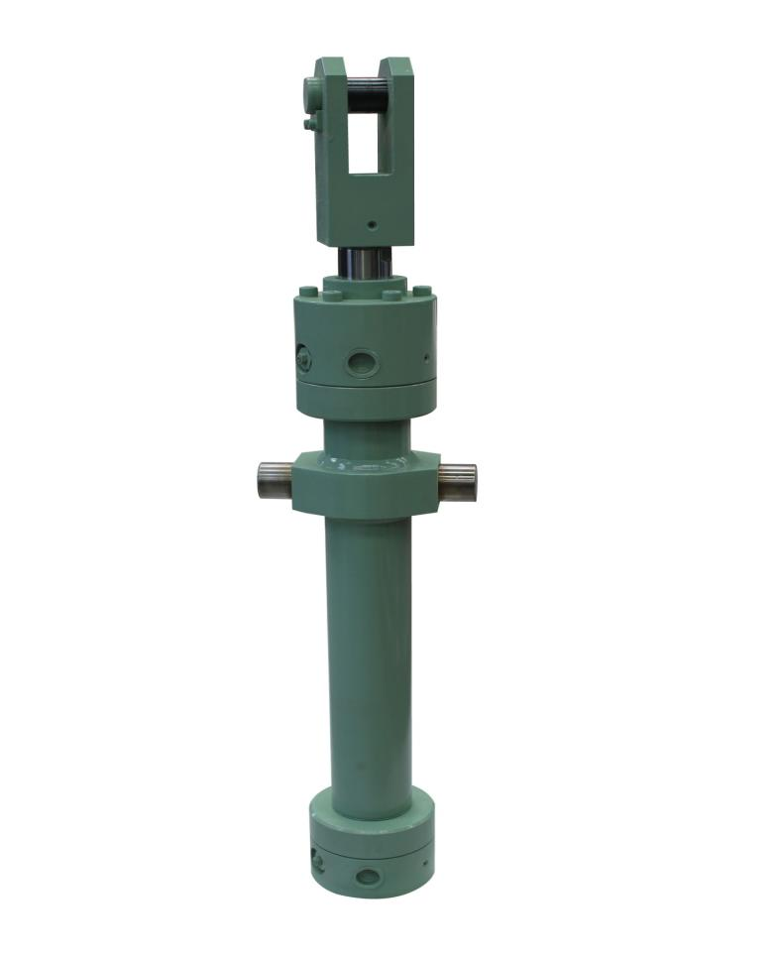
실적현황-2
계 약 명 | 계약금액 (단위:천원) | 제작 년도 | 규 격 | 최종 사용처
특장차 | 1,800,000 | 07~14년 | Φ160 x 700ST Φ160 X 338ST | 제작,판매
휠터프레스 | 360,000 | 05~14년 | Φ255 x 1000ST | 풍산금속
승기천와이어 당김用 | 180,000 | 09~14년 | Φ250 x 1235ST | 제작,판매
유압프레스 | 540,000 | 05~14년 | Φ300 x 2500ST Φ350 x 2500ST | 삼성전자
도량 공사용 | 672,000 | 07~14년 | Φ400 x 1500ST Φ350 x 2000ST | 두바이 (pja현장)
제철설비 | 300,000 | 07~14년 | Φ250 x 400ST Φ200 x 670ST | 포스코 2후판 신전단기라인 후판 SHEAR & COLD LEVELLER
성형사출기 | 720,000 | 08~14년 | Φ190 x 500ST | 제작,판매
www.dhcyl.co.kr
Technology and quality as much as any third party may have a higher self-esteem.
But, not satisfied with the current for greater customer satisfaction Invitational will continue to
strive to develop new technologies promise.
The best quality, best service, new product development under a management philosophy that
is committed to innovation.
DAE WHA

Slide 12
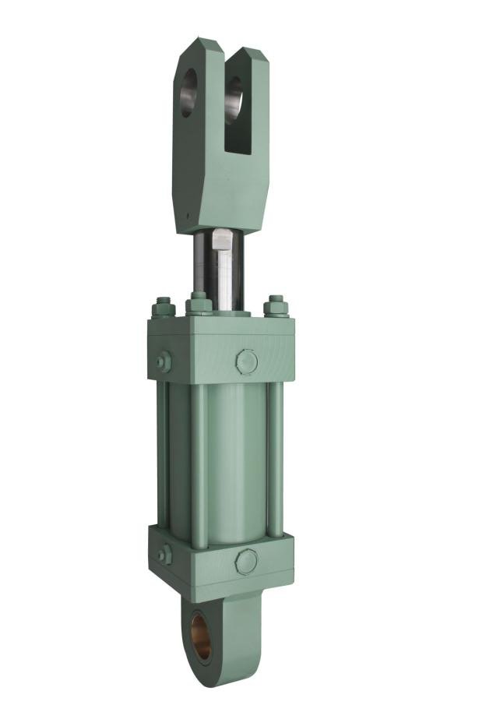
장비 보유현황
번호 | 적요 | 보유대수 | 구입처 | 품명
1 | CNC | 2 | 두산 인프라 코아 | CT 250, 300
2 | CNC | 3 | 두산 인프라 코아 | P-240MB
3 | CNC | 2 | 두산 인프라 코아 | P-240A
4 | CNC | 1 | 두산 인프라 코아 | P-300LC
5 | MCT | 1 | 두산 인프라 코아 | DNM400
6 | MCT | 2 | 두산 인프라 코아 | NYNX 5400
7 | 선 반 | 1 | 화 천 | 530 x 1550
8 | 선 반 | 1 | 화 천 | 400 x 1060
9 | 선 반 | 1 | 화 천 | 530 x 2000
10 | 선 반 | 1 | 화 천 | 630 x 3000
11 | 선 반 | 2 | 화 천 | 460 x 1000
12 | 선 반 | 1 | 화 천 | 400 x 1768
13 | 선 반 | 1 | 화 천 | 600 x 1500
14 | 선 반 | 1 | 화 천 | 850 x 4000
15 | 밀 링 | 4 | 화 천 | 2호기,3호기
16 | 레디얼 | 1 | 남 북 | 2000
17 | 레디얼 | 1 | 남 북 | 1600
www.dhcyl.co.kr
Technology and quality as much as any third party may have a higher self-esteem.
But, not satisfied with the current for greater customer satisfaction Invitational will continue to
strive to develop new technologies promise.
The best quality, best service, new product development under a management philosophy that
is committed to innovation.
DAE WHA

Slide 13
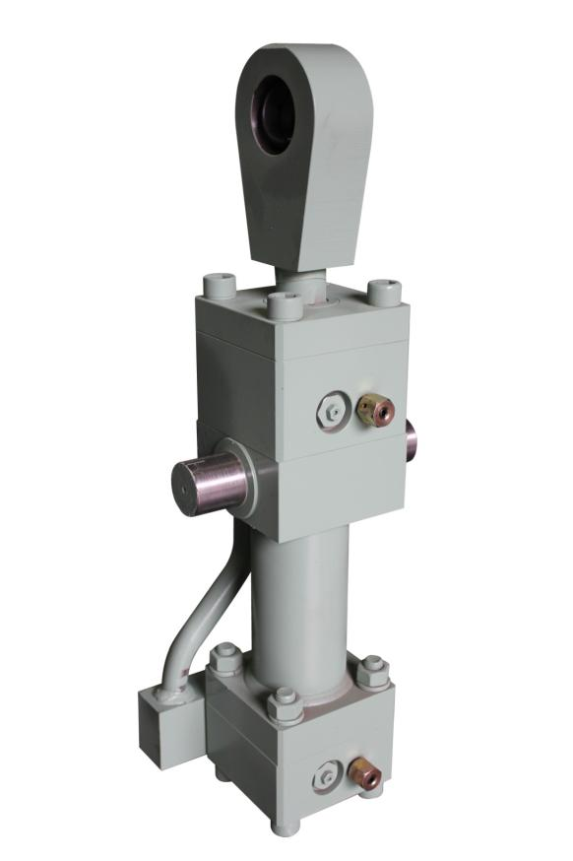
검사 및 시험장비 보유현황-1
번호 | 장 비 명 | 규 격 | 수량
1 | VERNIER CALIPERS | 600 m/m | 4EA
2 | VERNIER CALIPERS | 1000 m/m | 3EA
3 | 외경 MICRO METER | 0~25 | 4EA
4 | 외경 MICRO METER | 25~50 | 4EA
5 | 외경 MICRO METER | 50~75 | 4EA
6 | 외경 MICRO METER | 75~100 | 4EA
7 | 외경 MICRO METER | 100~125 | 4EA
8 | 외경 MICRO METER | 125~150 | 4EA
9 | 외경 MICRO METER | 150~175 | 3EA
10 | 외경 MICRO METER | 175~200 | 2EA
11 | 내경 MICRO METER | 200~250 | 2EA
12 | 내경 MICRO METER | 150~300 | 2EA
13 | 테스트장비(유압유니트) | 400Kgf/㎠ | 1대
14 | 테스트장비(유압유니트) | 700Kgf/㎠ | 1대
www.dhcyl.co.kr
Technology and quality as much as any third party may have a higher self-esteem.
But, not satisfied with the current for greater customer satisfaction Invitational will continue to
strive to develop new technologies promise.
The best quality, best service, new product development under a management philosophy that
is committed to innovation.
DAE WHA

Slide 14
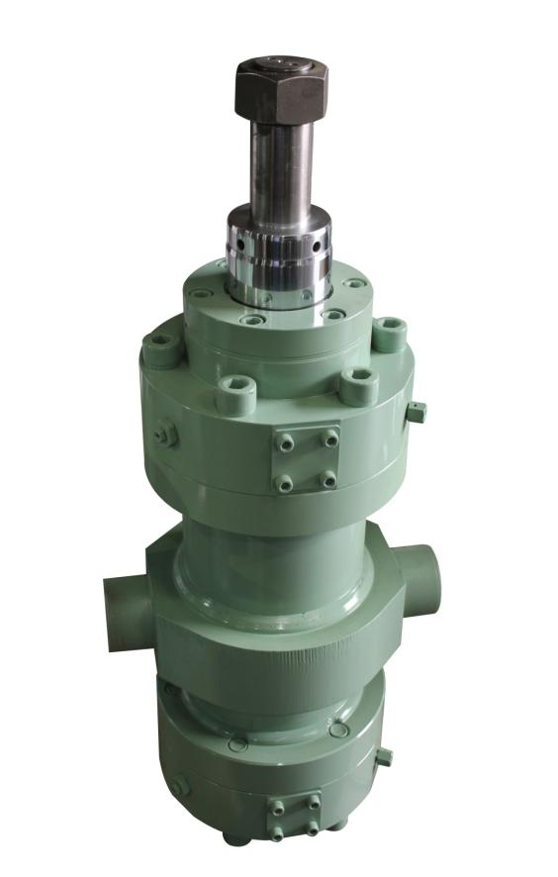
검사 및 시험장비 보유현황-2
번호 | 장 비 명 | 규 격 | 수량
15 | 내경 MICRO METER | 300~400 | 1EA
16 | CYLINDER GAUGE | 10~18 | 1EA
17 | CYLINDER GAUGE | 35~60 | 1EA
18 | CYLINDER GAUGE | 50~150 | 7EA
19 | CYLINDER GAUGE | 160~235 | 1EA
20 | CYLINDER GAUGE | 250~310 | 1EA
21 | 도막 측정기 |  | 1EA
22 | 쇼어 경도기 |  | 1EA
23 | DIAR CALIPERS | 20~35 | 1EA
24 | DIAR CALIPERS | 30~54 | 1EA
25 | DIAR CALIPERS | 35~62 | 1EA
26 | DIAR CALIPERS | 55~135 | 1EA
www.dhcyl.co.kr
Technology and quality as much as any third party may have a higher self-esteem.
But, not satisfied with the current for greater customer satisfaction Invitational will continue to
strive to develop new technologies promise.
The best quality, best service, new product development under a management philosophy that
is committed to innovation.
DAE WHA

Slide 15
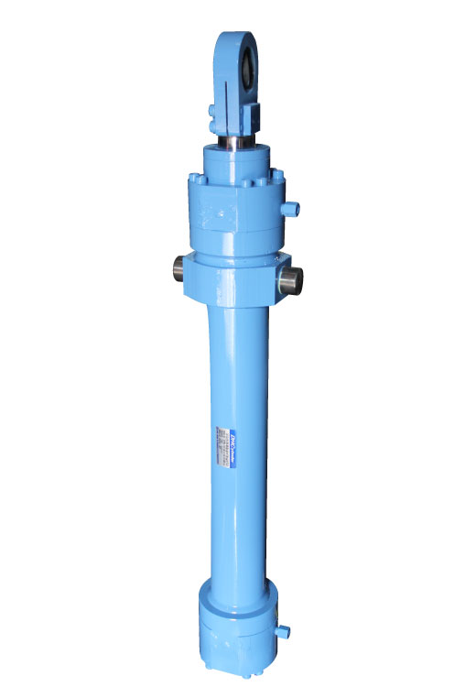
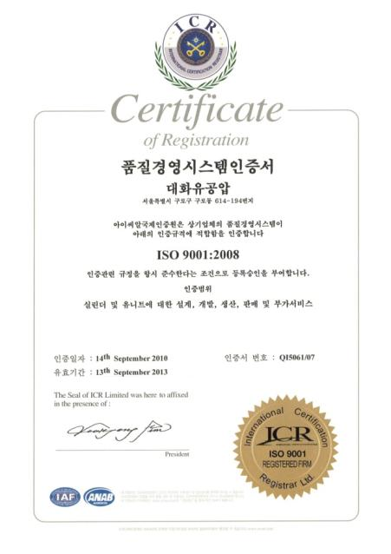
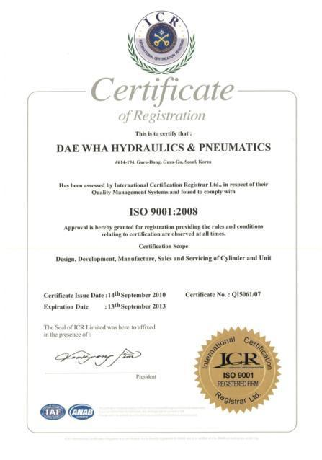
인증서-1
품질경영시스템 인증서 ISO 9001 : 2008
www.dhcyl.co.kr
Technology and quality as much as any third party may have a higher self-esteem.
But, not satisfied with the current for greater customer satisfaction Invitational will continue to
strive to develop new technologies promise.
The best quality, best service, new product development under a management philosophy that
is committed to innovation.
DAE WHA

Slide 16
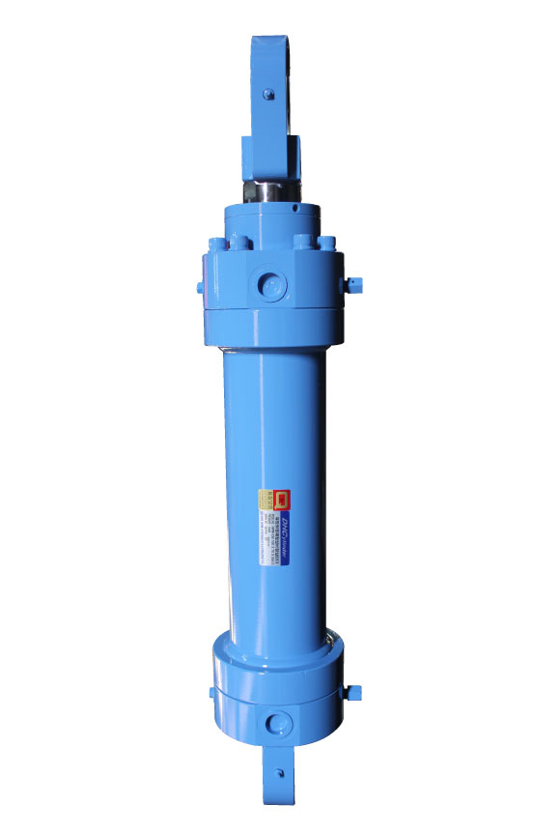
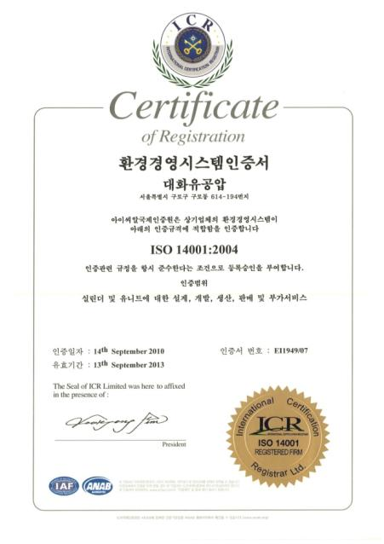
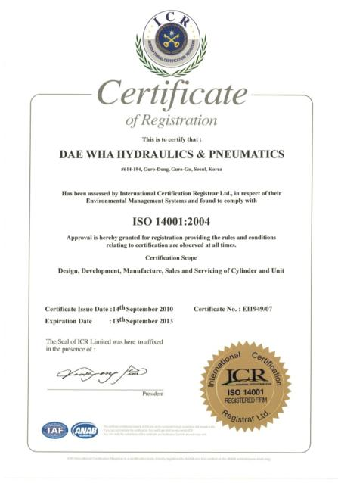
인증서-2
환경경영시스템 인증서 ISO 1401 : 2004
www.dhcyl.co.kr
Technology and quality as much as any third party may have a higher self-esteem.
But, not satisfied with the current for greater customer satisfaction Invitational will continue to
strive to develop new technologies promise.
The best quality, best service, new product development under a management philosophy that
is committed to innovation.
DAE WHA

Slide 17
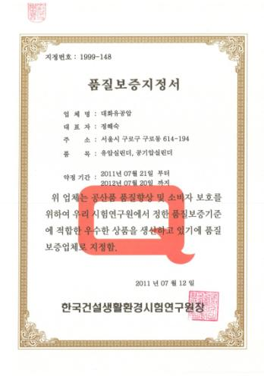
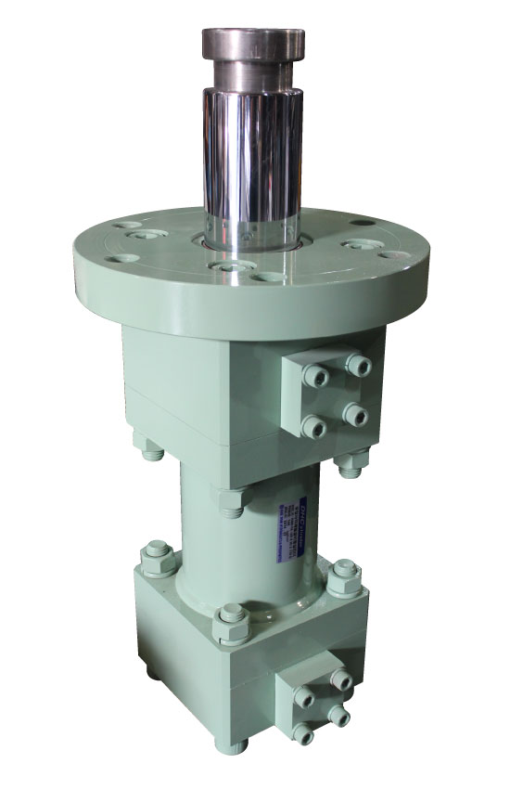
인증서-3
품질보증 지정서
www.dhcyl.co.kr
Technology and quality as much as any third party may have a higher self-esteem.
But, not satisfied with the current for greater customer satisfaction Invitational will continue to
strive to develop new technologies promise.
The best quality, best service, new product development under a management philosophy that
is committed to innovation.
DAE WHA

Slide 18
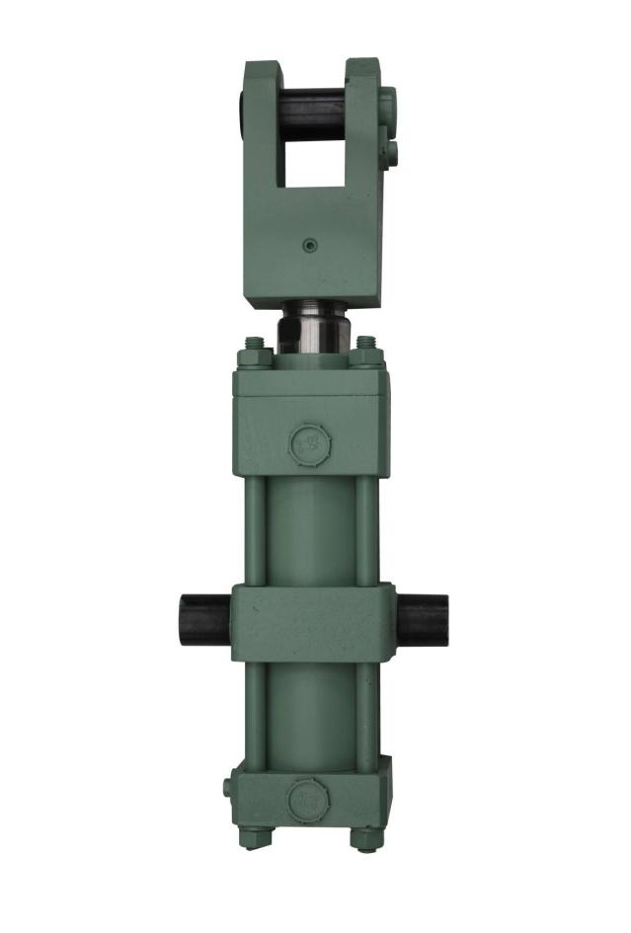









주요 고객사
www.dhcyl.co.kr
Technology and quality as much as any third party may have a higher self-esteem.
But, not satisfied with the current for greater customer satisfaction Invitational will continue to
strive to develop new technologies promise.
The best quality, best service, new product development under a management philosophy that
is committed to innovation.
DAE WHA

Slide 19
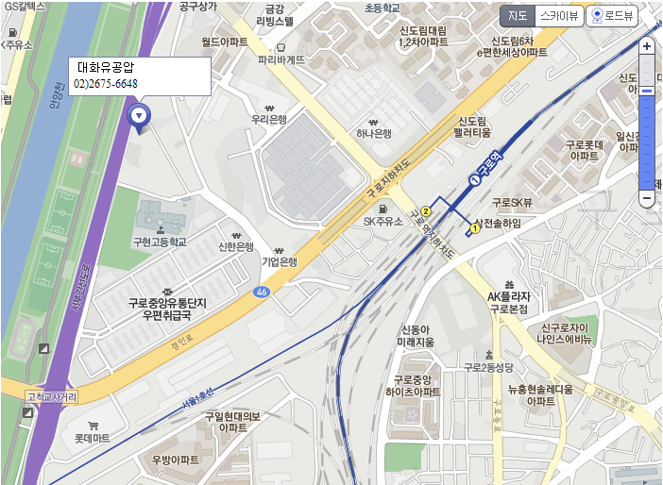
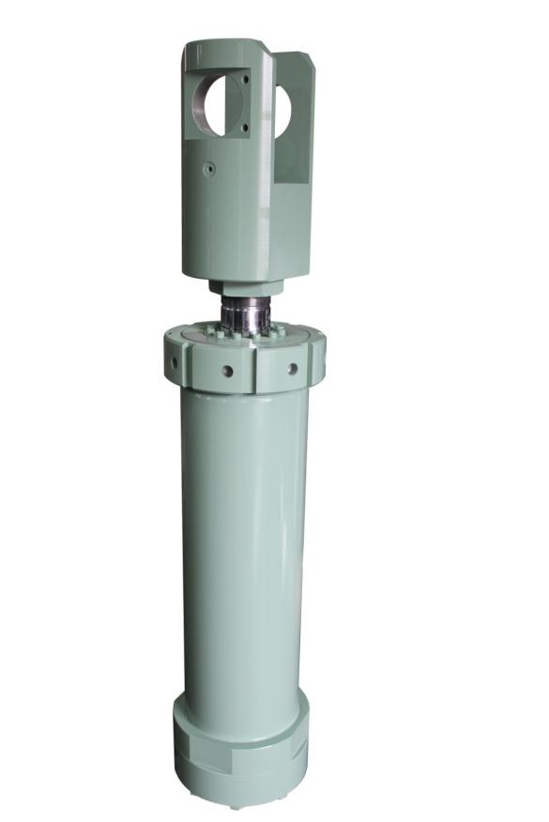
오시는 길
ADRESS - 서울시 구로구 경인로 51길 114(구로동)
www.dhcyl.co.kr
Technology and quality as much as any third party may have a higher self-esteem.
But, not satisfied with the current for greater customer satisfaction Invitational will continue to
strive to develop new technologies promise.
The best quality, best service, new product development under a management philosophy that
is committed to innovation.
DAE WHA

Slide 20
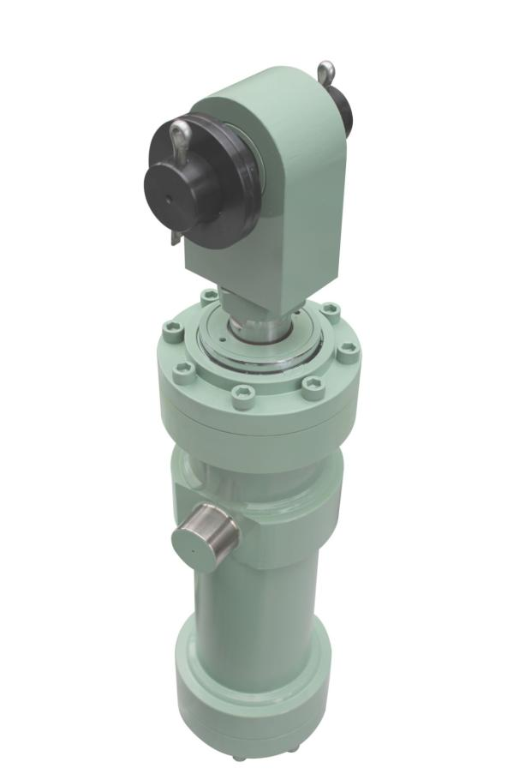
Thank YOU!
www.dhcyl.co.kr
Technology and quality as much as any third party may have a higher self-esteem.
But, not satisfied with the current for greater customer satisfaction Invitational will continue to
strive to develop new technologies promise.
The best quality, best service, new product development under a management philosophy that
is committed to innovation.
DAE WHA

